Slide 1
Household Income Activity
1. Rank the household incomes from the lowest to the highest.
2. Determine the aggregate (total) income for the country.
3. Determine the median and the mean income for the country.
4. Divide the households into five equal groups.
5. Determine the aggregate income for each group.
6. Determine the percent of income each group has of the aggregate or total income. (Divide the aggregate income of each group by the overall aggregate income of all households.)

Slide 2
Household Distribution of Income
Fictitious Country
Aggregate (total) household income =
Ranking of Household Groups | Aggregate Income by Group | Percent Distribution of Aggregate Income
Lowest
Second
Third
Fourth
Highest

Slide 3
Mean Household Income (in dollars) Received by Quintiles
Year | Lowest Quintile | Second Quintile | Third Quintile | Fourth Quintile | Highest Quintile
1970 | 10,512 | 28,475 | 45,852 | 64,633 | 114,421
1980 | 11,435 | 28,459 | 46,961 | 69,186 | 123,358
1990 | 12,204 | 30,706 | 50,718 | 76,468 | 148,397
2000 | 13,543 | 33,815 | 56,311 | 87,537 | 189,692
2010 | 11,578 | 30,047 | 51,777 | 83,065 | 178,384

Slide 4
Share of Aggregate Income Received by Quintiles
Year | Percent Distribution of Aggregate Income
 | Lowest Quintile | Second Quintile | Third Quintile | Fourth Quintile | Highest Quintile
1970 | 4.1 | 10.8 | 17.4 | 24.5 | 43.3
1980 | 4.2 | 10.2 | 16.8 | 24.7 | 44.1
1990 | 3.8 | 9.6 | 15.9 | 24.0 | 46.6
2000 | 3.6 | 8.9 | 14.8 | 23.0 | 49.8
2009 | 3.3 | 8.5 | 14.6 | 23.4 | 50.3
Source: U.S. Census Bureau, Statistical Abstract of the United States: 2012 (131st edition) Washington, DC, 2011; http://www.census.gov/compendia/statab/

Slide 5
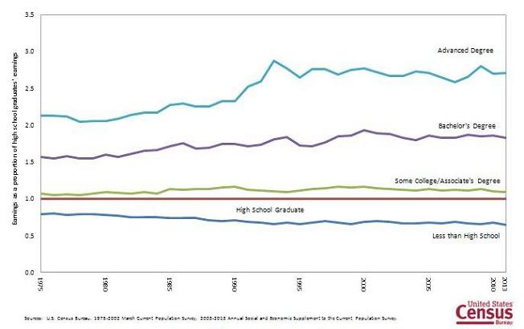
Average Earnings of Full-time, Year-round Workers as a Proportion of the Average Earnings of High School Graduates by Educational Attainment: 1975 to 2013

